Slide 1

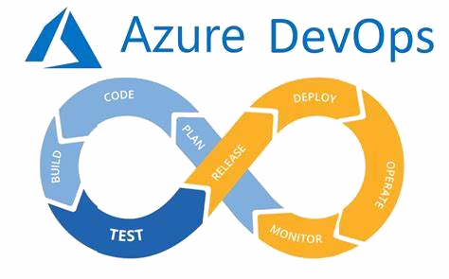
Power BI access to Azure DevOps
Valmir Meneses
April, 17th, 2024
Extended Play Version – 6 Tracks only

Slide 2


An inside view on Azure DevOps
Power BI Access to Azure DevOps
Side A
1. Someone’s knocking at the door... Get/provide access to ADO by PAT
2. Who are you … who, who? Use the PAT to access ADO
3. I couldn't love you any better I love you just the way you are ADO Analytics from Power BI
4. The secret is about to unfold, Upstairs before the night's too old Access ADO using OData
5. giMMe shelter The available tables with M
6. Ob-La-Di, Ob-La-DAX Calculated columns

Slide 3



I am VALmir Meneses
Cloud Solution Architect (CSA) Data & AI
Certified Microsoft Azure DevOps Engineer Expert Microsoft Certified: Power BI Data Analyst Associate
Whilst not working, I enjoy cooking and listening to rock’n roll

Slide 4


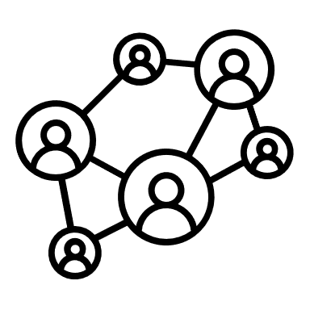
Rationale
Why access ADO data from Power BI?
Customize reporting of ADO
Build reports not available in the GUI
Build analytics on ADO data
Team Members
Team Leaders
Measure own performance
Explain impacts of issues
Report on assigned WorkItems
Measure team performance
Measure members performance
Report on Progress

Slide 5
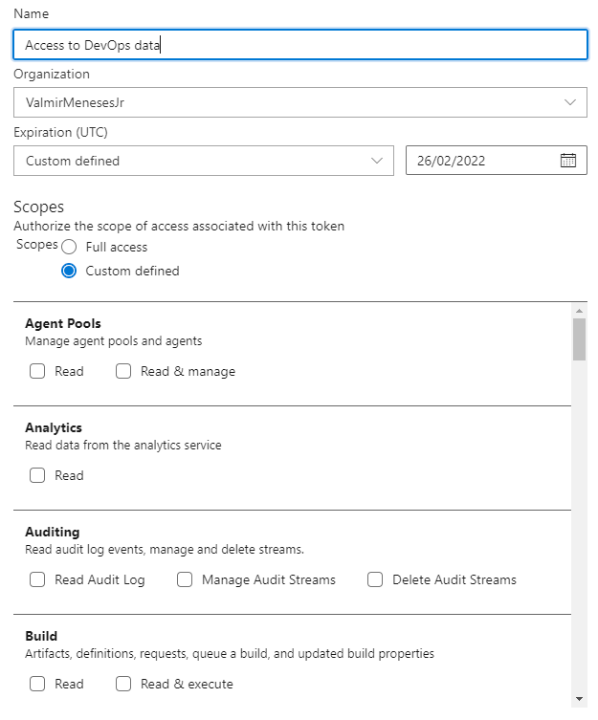
“…Someone's knocking at the door. Somebody's ringing the bell Do me a favor Open the door and let 'em in, yeah, yeah, yeah, yeah, yeah” Let 'Em In by Wings ,circa 1976
Azure DevOps data access can be done by Personal Access Tokens.
The token can be created with very specific permissions. Currently, there are 35 scopes for the permissions
https://docs.microsoft.com/en-us/azure/devops/organizations/accounts/use-personal-access-tokens-to-authenticate?

Slide 6
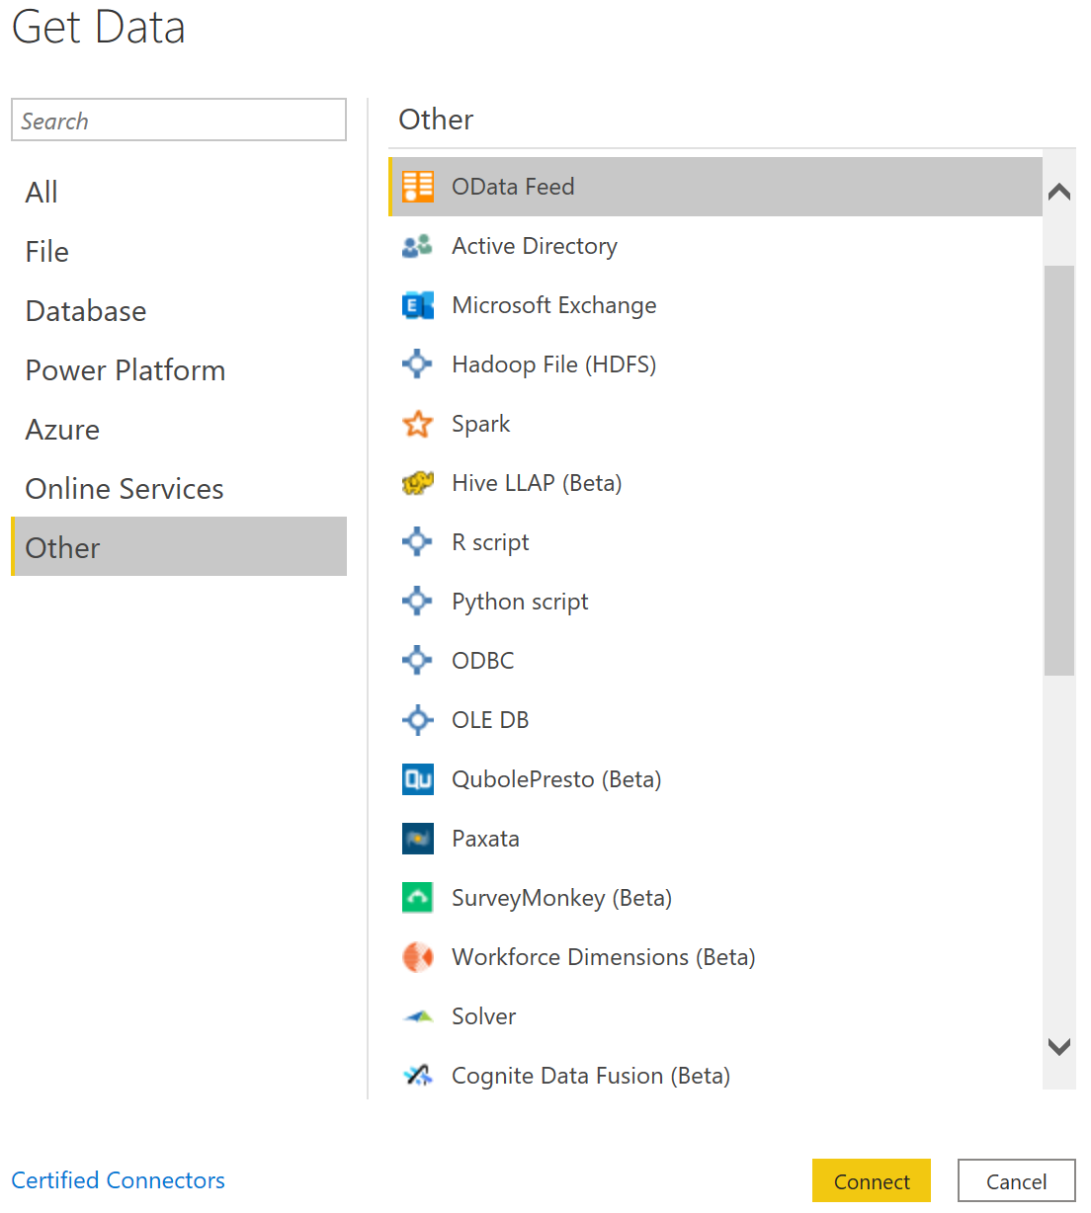
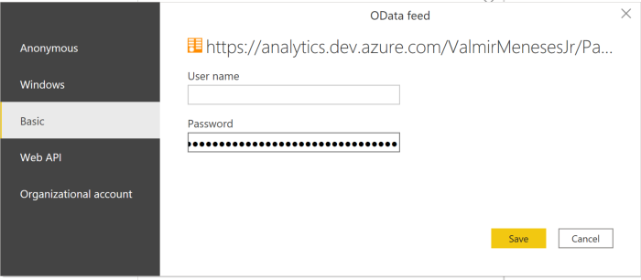
“Who are you? Who, who, who, who?”
Who are you by The Who ,circa 1978
When connecting with a PAT, choose Basic Authentication.
User Name = (empty)
Password = PAT
There is a difference between the ways you connect with Power BI.
As Odata Feed, you will be able to see most of the data stored in ADO and create your own Key Indicators.
https://docs.microsoft.com/en-us/azure/devops/report/powerbi/data-connector-dataset?view=azure-devops

Slide 7
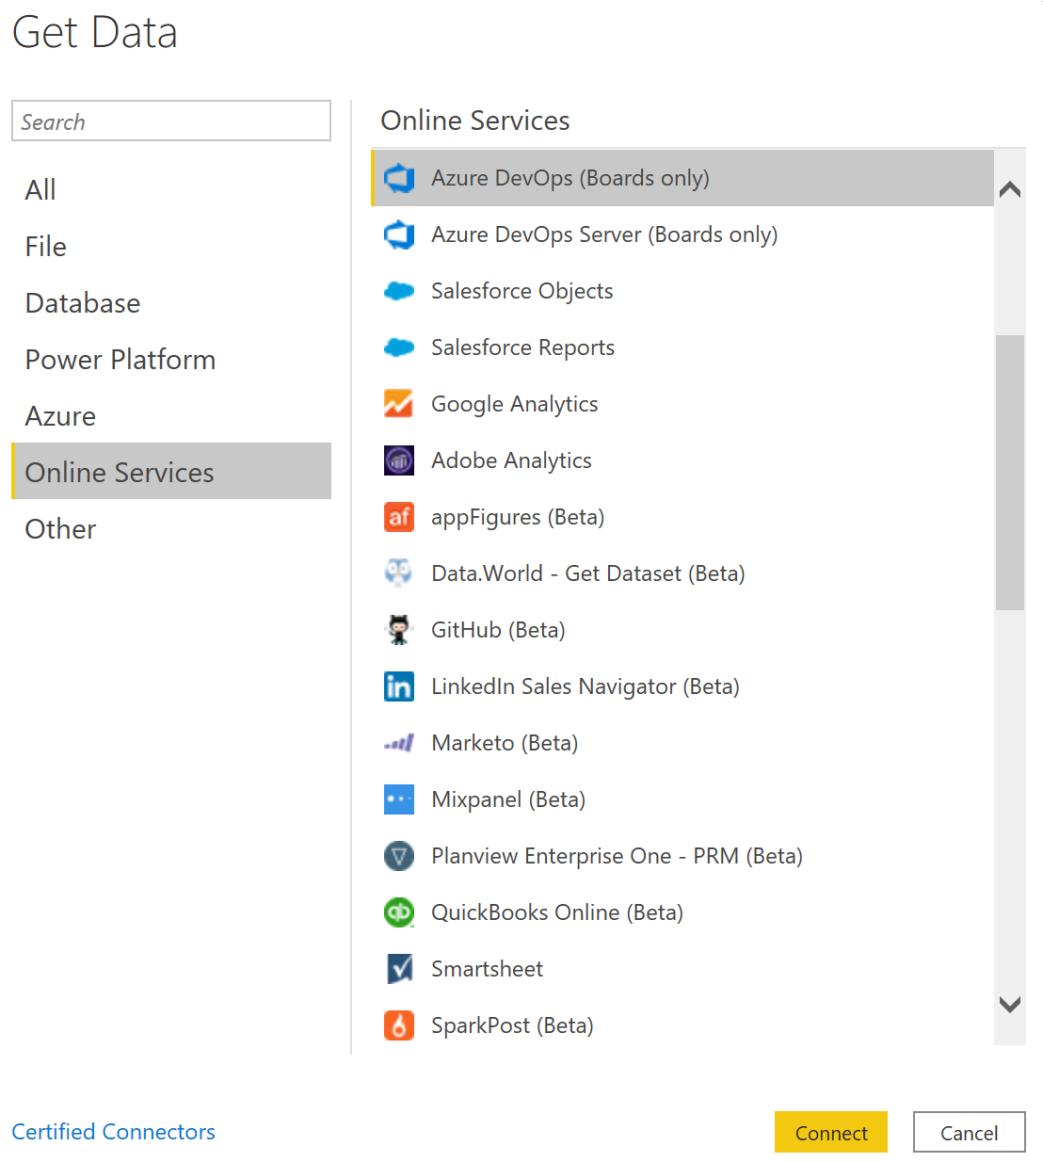
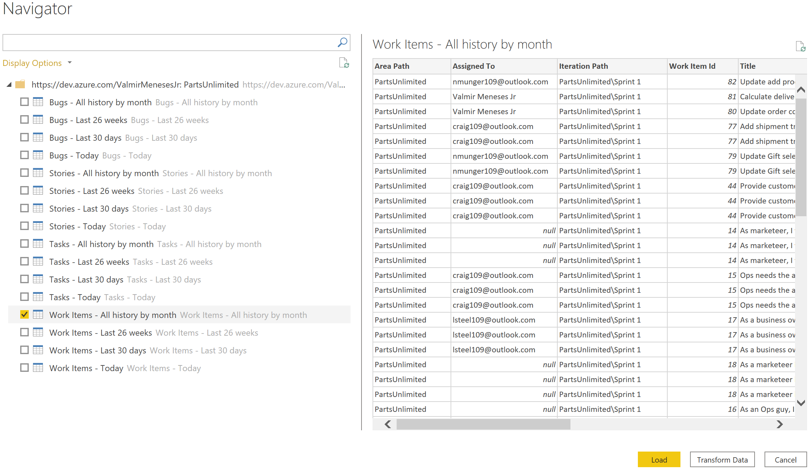
“I couldn't love you any better , I love you just the way you are …”
Just the way you are by Billy Joel, circa 1977
As an Online Services, you will be able to see Boards Only data.

Slide 8
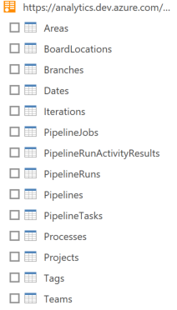
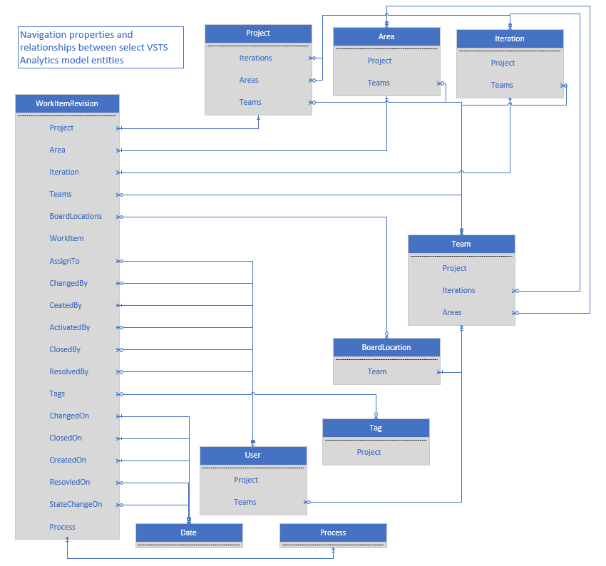
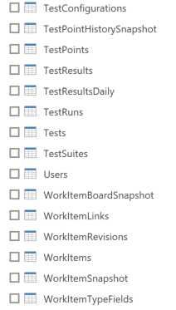
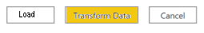
“…The secret is about to unfold, Upstairs before the night's too old…”
Tonight’s the night (Gonna Be Alright) by Rod Stewart , circa 1976
As OData, you will be able to see it all
Transform data option will give you more flexibility!
https://docs.microsoft.com/en-us/azure/devops/report/extend-analytics/data-model-analytics-service?view=azure-devops

Slide 9
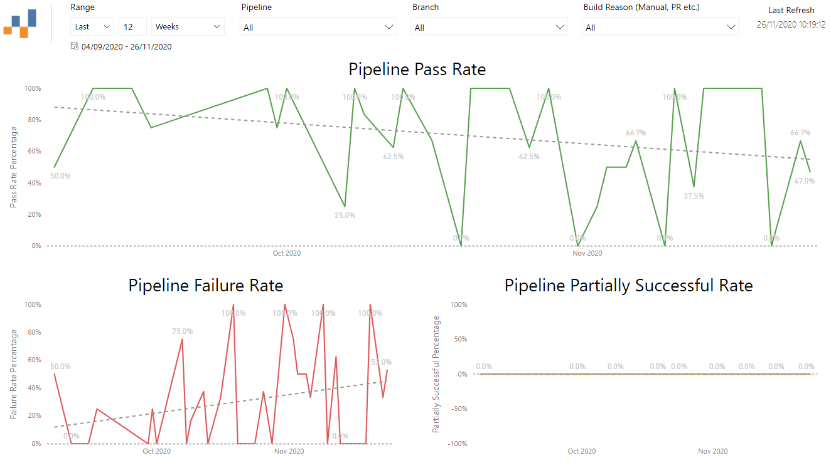
“I tell you love… sister… It's just a kiss away”
Gimme Shelter by The Rolling Stones , circa 1969
Azure Boards | Azure Test Plans | Azure Pipelines | Azure Pipeline & Test
Open Bugs | Progress Status | Outcome Summary | Test Summary
Bug Trend | Requirements Tracking & Traceability | Outcome Summary for all Pipelines | Test Summary Trend
Rollup | Test Status Report | Pass Rate Trend | Failed Tests
Feature Progress | Test Execution Trend | Stage/Task/Job Wise Failures | Flaky Tests
Work Items With Direct Links | Test Suites Aggregated View | Pipeline Duration | Test Duration
Sprint Burndown | Tester by Outcome Matrix | Duration Trend | Test Duration Trend
Cumulative Flow Diagram (CFD) | Test Configuration Outcome Matrix | Task Duration | Pass Rate Trend of a Test
Lead/Cycle Time |  | Task Duration Trend
Sample reports available
https://github.com/nbrown02/AzureDevOps-OData-SampleReports

Slide 10
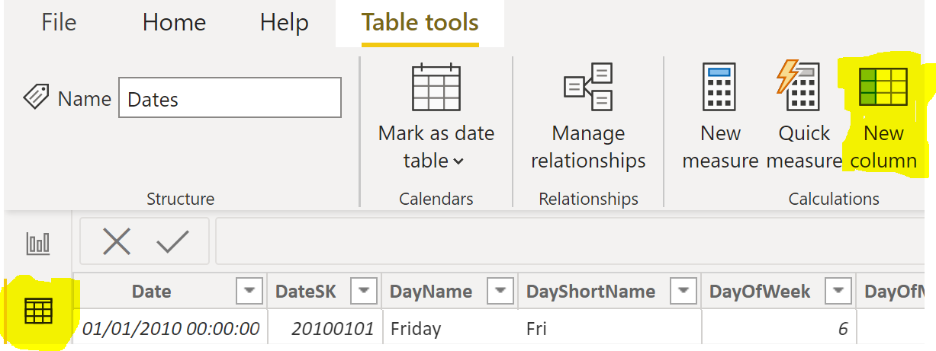
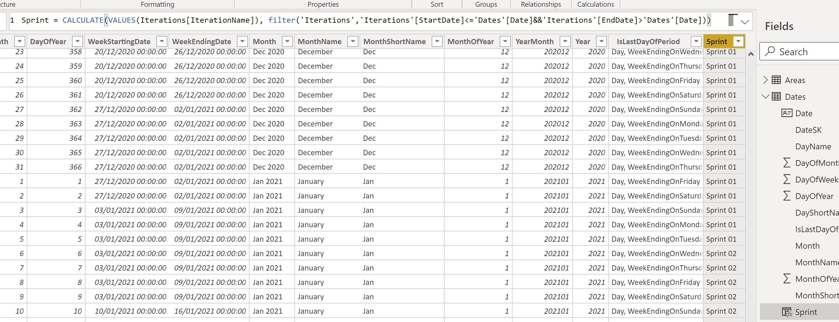
“Yeah! Ob-la-di, ob-la-DAX, Life goes on”
Ob-La-Di, Ob-La-Da by The Beatles, circa 1968
The dates in the entities columns are in a regular date format but it is quite useful if we can refer to the dates as a sprint period.
New column icon or right-click on the Dates Table + New Column
In Data view
Click on Dates
table
Sprint = CALCULATE(VALUES(Iterations[IterationName]),
filter('Iterations','Iterations'[StartDate]<='Dates'[Date]
&&'Iterations'[EndDate]>'Dates'[Date]))

Slide 11
“Yeah! Ob-la-di, ob-la-DAX, Life goes on”
Ob-La-Di, Ob-La-Da by The Beatles, circa 1968
And now the same “dance move” for the WorkItems table. Some useful Key Indicators and Hacks
US closed only in Planning next sprint
InProgressSprint = LOOKUPVALUE(Dates[Sprint],Dates[DateSK],WorkItems[InProgressDateSK])
CompletedSprint = LOOKUPVALUE(Dates[Sprint],Dates[DateSK],WorkItems[CompletedDateSK])
ActivatedSprint = LOOKUPVALUE(Dates[Sprint],Dates[DateSK],WorkItems[ActivatedDateSK])
ClosedSprint = LOOKUPVALUE(Dates[Sprint],Dates[DateSK],WorkItems[ClosedDateSK])
ClosedLateSprint = LOOKUPVALUE(Dates[Sprint],Dates[DateSK],VALUE(Format(WorkItems[ClosedDate]-1,"yyyyMMdd")))
ResolvedSprint = LOOKUPVALUE(Dates[Sprint],Dates[DateSK],WorkItems[ResolvedDateSK])
CreatedSprint = LOOKUPVALUE(Dates[Sprint],Dates[DateSK],WorkItems[CreatedDateSK])
Team=LOOKUPVALUE(Areas[AreaPath],Areas[AreaSK],WorkItems[AreaSK])
AssignedTo=LOOKUPVALUE(Users[UserName],Users[UserSK],WorkItems[AssignedToUserSK])
ActivatedBy=LOOKUPVALUE(Users[UserName],Users[UserSK],WorkItems[ActivatedByUserSK])
CreatedBy=LOOKUPVALUE(Users[UserName],Users[UserSK],WorkItems[CreatedByUserSK])
ResolvedBy=LOOKUPVALUE(Users[UserName],Users[UserSK],WorkItems[ResolvedByUserSK])
Iteration=LOOKUPVALUE(Iterations[IterationName],Iterations[IterationSK],WorkItems[IterationSK])
ClosedSprintPeriod = WorkItems[ClosedLateSprint] & " (" & Format(LOOKUPVALUE(Iterations[StartDate],Iterations[IterationName],WorkItems[ClosedLateSprint]),"mmm/dd") & " to "
& Format(LOOKUPVALUE(Iterations[EndDate],Iterations[IterationName],WorkItems[ClosedLateSprint]),"mmm/dd") & " )"
UserStory = IF(WorkItems[WorkItemType]="User Story",1,0)
UserStoryInSprint = IF(WorkItems[ActivatedSprint]=WorkItems[ClosedLateSprint],1,0)
US_StoryPoints = IF(WorkItems[StoryPoints]<1,2, WorkItems[StoryPoints])
StoryPointsInSprint = WorkItems[US_StoryPoints]*WorkItems[UserStoryInSprint]
US closed in the same sprint it was activated

Slide 12
“Oh! I believe in yesterday”
Yesterday by The Beatles, circa 1965
Leading Edge Delivery principle: Use telemetry to fundament actions.
Azure DevOps UI query builder does not allow some constructions:
How long was a task in Blocked state?
Which USs returned to the Product backlog after being assigned to a sprint?
Which USs had the priority updated?
Which USs had the estimate updated?
Which USs have not been updated in the last 5 days?
Which USs changed the Assigned team member?

Slide 13
Thank You!

Slide 14
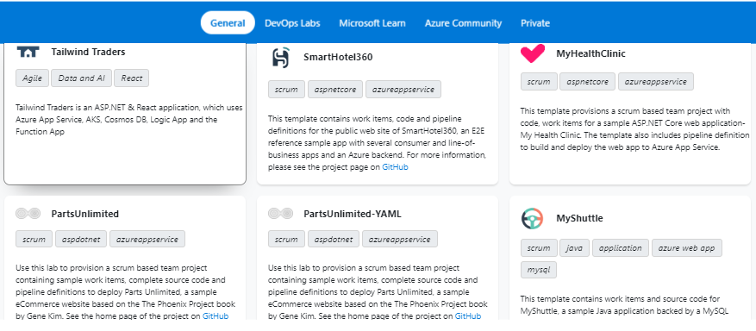
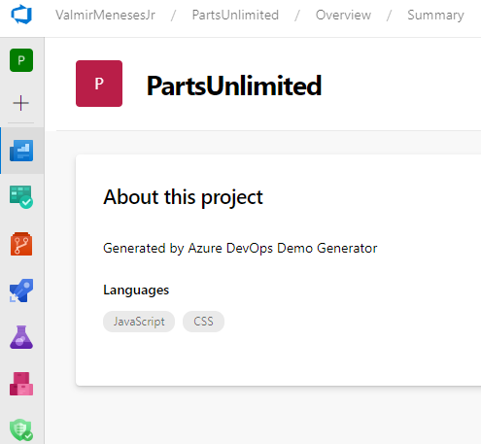
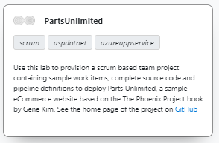
Bonus track “…Hey (hey), you (you). Get off of my cloud…”
Get off of my cloud by The Rolling Stones, circa 1965
Azure DevOps Demo Generator https://azuredevopsdemogenerator.azurewebsites.net/
Diverse templates choice:

Slide 15
Some feature or tools could be useful to a Scrum Master or Dev / Tech Lead role:
Tag the higher hierarchies work items to show there is a blocked task in that workstream;
Create a visual link between dependent Features/deliverables;
Optionally move higher hierarchies work items (avoid unparented tasks in a sprint backlog if US is another sprint);
Create Activity (Testing, Development, Deployment) metrics or Burndown chart;
Export WIKI documentation branch to PDF/Word;
Update lower or higher hierarchies dates for delivery when work item is delayed/postponed (E.g. like in MS Project)

Slide 16
Useful links
5 Super Useful Azure DevOps Extensions | https://devblogs.microsoft.com/premier-developer/5-super-useful-azure-devops-extensions/
Syntax for the Work Item Query Language (WIQL) | https://docs.microsoft.com/en-us/azure/devops/boards/queries/wiql-syntax?view=azure-devops
Analytics views dataset design | https://docs.microsoft.com/en-us/azure/devops/report/powerbi/data-connector-dataset?view=azure-devops
Query guidelines for Analytics with OData | https://docs.microsoft.com/en-us/azure/devops/report/extend-analytics/odata-query-guidelines?view=azure-devops
Data model for Analytics | https://docs.microsoft.com/en-us/azure/devops/report/extend-analytics/data-model-analytics-service?view=azure-devops
Report samples | https://github.com/MicrosoftDocs/azure-devops-docs/blob/master/docs/report/extend-analytics/aggregated-data-analytics.md
Overview of sample reports using OData queries | https://docs.microsoft.com/en-us/azure/devops/report/powerbi/sample-odata-overview?view=azure-devops

Slide 17
Resources used for this presentation
https://learn.microsoft.com/en-us/rest/api/azure/devops/?view=azure-devops-rest-7.2
https://learn.microsoft.com/en-us/azure/devops/integrate/how-to/call-rest-api?view=azure-devops
https://learn.microsoft.com/en-us/azure/devops/integrate/get-started/rest/samples?view=azure-devops
https://docs.microsoft.com/en-us/azure/devops/report/extend-analytics/quick-ref?view=azure-devops
https://azuredevopsdemogenerator.azurewebsites.net/environment/createproject
https://github.com/microsoft/devops-project-samples
https://microsoft.github.io/PartsUnlimited/pandp/200.1x-PandP-CICDQuickstartwithVSTS.html
https://docs.microsoft.com/en-us/azure/devops/integrate/quickstarts/work-item-quickstart?view=azure-devops
https://docs.microsoft.com/en-us/azure/devops/demo-gen/use-demo-generator-v2?view=azure-devops
https://docs.microsoft.com/en-us/azure/devops/boards/queries/query-by-date-or-current-iteration?view=azure-devops#query-for-items-based-on-belonging-to-a-teams-current-iteration
https://docs.microsoft.com/en-gb/cli/azure/install-azure-cli-windows?view=azure-cli-latest
https://docs.microsoft.com/en-us/azure/devops/report/powerbi/sample-boards-leadcycletime?view=azure-devops&tabs=powerbi
https://docs.microsoft.com/en-us/azure/devops/organizations/settings/set-iteration-paths-sprints?view=azure-devops&tabs=azure-devops-cli
https://docs.microsoft.com/en-us/azure/devops/boards/queries/titles-ids-descriptions?view=azure-devops
https://docs.microsoft.com/en-us/azure/devops/boards/queries/query-operators-variables?view=azure-devops
https://docs.microsoft.com/en-us/azure/devops/boards/queries/example-queries?view=azure-devops
https://docs.microsoft.com/en-us/azure/devops/boards/queries/history-and-auditing?view=azure-devops&tabs=browser
https://docs.microsoft.com/en-us/azure/devops/boards/queries/using-queries?view=azure-devops
https://docs.microsoft.com/en-us/azure/devops/boards/queries/wiql-syntax?view=azure-devops
https://docs.microsoft.com/en-us/azure/devops/boards/queries/example-queries?view=azure-devops#examples
https://docs.microsoft.com/en-us/azure/devops/boards/queries/query-index-quick-ref?view=azure-devops
https://docs.microsoft.com/en-us/azure/devops/boards/queries/wiql-syntax?view=azure-devops
https://docs.microsoft.com/en-us/azure/devops/boards/queries/query-by-workflow-changes?view=azure-devops

Slide 18
Resources used for this presentation
https://www.visualstudiogeeks.com/azure/azure-devops-create-info-banner-for-all-users?
https://documentation.help/TFS-2003/2e035f4a-c542-487f-96f9-d730e4700af2.htm
https://documentation.help/TFS-2003/2fee2b45-55f1-4b7c-ab10-8be80eb283f1.htm
http://apievangelist.com/2020/01/22/three-ways-to-use-postman-and-azure-devops/
https://elanderson.net/2018/11/azure-devops-project/
https://github.com/hkamel/azuredevops-postman-collections
https://medium.com/@shanmugamchinnappa/securely-configuring-azure-devops-pipeline-for-api-functional-integration-testing-2eba5bbbec91
https://documenter.getpostman.com/view/966996/SW7XYoLy?version=latest
https://mohamedradwan.com/2011/08/02/hello-world-tfs-sdk/
https://stackoverflow.com/questions/52760762/filtering-a-wiql-query-with-c-sharp
https://www.c-sharpcorner.com/blogs/how-to-get-azure-devops-data
https://marketplace.visualstudio.com/items?itemName=Quadrotech.ADOScheduledWorkItemQuery
https://developercommunity.visualstudio.com/idea/365496/send-email-with-query-results-on-a-schedule.html
https://hub.packtpub.com/creating-tfs-scheduled-jobs/
https://github.com/MicrosoftDocs/azure-devops-docs/blob/master/docs/boards/backlogs/office/rollup-estimated-and-actual-work-using-project.md
https://medium.com/into-alm/the-good-old-asof-clause-in-wiql-queries-for-azure-devops-abf4960bca4f
http://www.codewrecks.com/blog/index.php/2019/02/03/wiql-editor-extension-for-azure-devops/
https://gist.github.com/pietergheysens
https://www.reddit.com/r/azuredevops/comments/cwthpj/downloading_queries/
http://www.woodwardweb.com/vsts/tfs_top_tip_1_w.html
https://til.secretgeek.net/azure_devops/wiql_editor.html
http://danlec.com/st4k#questions/59149875
http://danlec.com/st4k#questions/41841613
https://edsquared.com/grouping-conditional-clauses-in-work-item-queries-31b27ec37cda
https://blogs.endjin.com/2016/07/querying-the-vsts-work-items-api-directly-from-power-bi/
https://www.c-sharpcorner.com/blogs/how-to-get-azure-devops-data
https://www.dotnetcurry.com/devops/1485/using-rest-api-azure-devops
http://danlec.com/st4k#questions/29629430

